Slide 1
Respiration
Physical Respiration and the Human Respiratory System

Slide 2
I. Physical Respiration
a) Definition: the process in which oxygen is taken in and carbon dioxide is released from an organism.
1. Oxygen is needed for the chemical reactions of aerobic cellular respiration.
2. Carbon dioxide is a metabolic waste of cellular respiration.

Slide 3
b) Respiratory Surfaces
1. Large animals developed a variety of respiratory surfaces that increases the surface area for exchange, thus allowing for larger bodies.
2. A respiratory surface is covered with thin, moist epithelial cells that allow oxygen and carbon dioxide to exchange. Those gases can only cross cell membranes when they are dissolved in water or an aqueous solution, thus respiratory surfaces must be moist.

Slide 4
b) Modes of Physical Respiration
1. Simple Organisms (unicellular and simple multicellular organisms)
Simple organisms do not require a specialized way for physical respiration. Oxygen and carbon dioxide diffuses directly into and out of the simple organisms.
Examples of simple organisms includes: Monera (bacteria), Protist (ameba, paramecium, algae), Fungus (mushroom, yeast, mold).

Slide 5
2. Complex Organisms (multicellular, highly specialized organisms)
Complex organisms includes higher plants and animals.
Complex organisms requires specialized structures to obtain oxygen and release carbon dioxide.
In the case of complex animals, a respiratory system must exist.
Breathing in mammals involves the diaphragm: a muscle that divides the body cavity into the abdominal cavity and the thoracic (chest) cavity, which contains the heart and lungs.

Slide 6
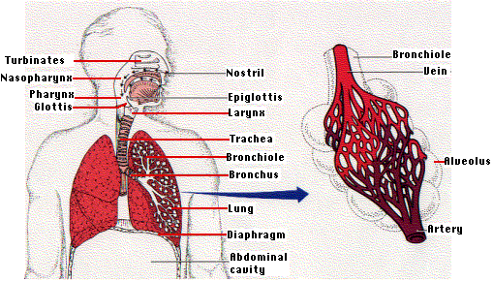
II. The Human Respiratory System

Slide 7
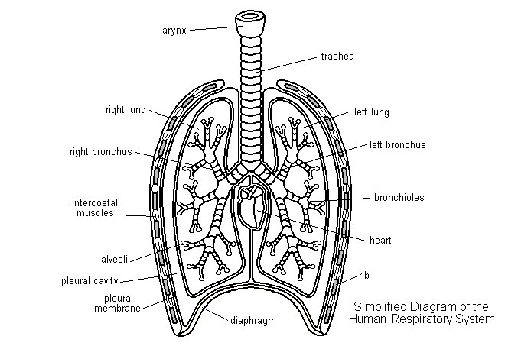

Slide 8
a) Structures of the Human Respiratory System
1. The NOSE (nasal cavity) is the preferred entrance for outside air into the respiratory system. The hairs that line the wall are part of the air-cleaning system.
2. Air also enter through the MOUTH (oral cavity), especially in people who have a mouth-breathing habit or whose nasal passages may be temporarily obstructed, as by a cold or during heavy exercise.
3. The THROAT (pharynx) collects incoming air from the nose and mouth and passes it downward to the windpipe (trachea).

Slide 9
4. The EPIGLOTTIS is a flap of tissue that guards the entrance to the windpipe (trachea), closing when anything is swallowed that should go into the esophagus and stomach.
5. The VOICE BOX (larynx) contains the vocal chords. It is the place where moving air being breathed in and out creates voice sounds.
6. The WINDPIPE (trachea) is the passage leading from the throat (pharynx) to the lungs.
7. The windpipe divides into the two main BRONCHIAL TUBES, one for each lung, which subdivide into each lobe of the lungs. These, in turn, subdivide further.

Slide 10
8. The smallest subdivisions of the bronchial tubes are called BRONCHIOLES, at the end of which are the air sacs or alveoli (plural of alveolus).
9. The ALVEOLI are the very small air sacs that are the destination of air breathed in. The CAPILLARIES are blood vessels that are imbedded in the walls of the alveoli that allows oxygen and carbon dioxide to diffuse between the lungs to the blood.
10. The DIAPHRAGM is the strong wall of muscle that separates the chest cavity from the abdominal cavity. By moving downward, it creates suction in the chest to draw in air and expand the lungs.

Slide 11
b) Protecting Your Respiratory System
1. The bronchial tubes are lines with CILIA (like very small hairs) that have a wave-like motion.
2. This motion carried MUCUS (sticky phlegm or liquid) upward and out into the throat, where it is either coughed up or swallowed.
The mucus catches and holds much of the dust, germs, and other unwanted matte that has invaded the lungs.
You get rid of this matter when you cough, sneeze, clear your throat or swallow.

Slide 12
c) The Control of Breathing
1. It is a rising concentration of carbon dioxide that plays the major role in regulating breathing. However, the medulla oblongata also has receptors that respond to a drop in oxygen.
2. The concentration of CO2 is monitored by cells in the medulla oblongata. If the level rises, the medulla responds by increasing the activity of the nerves that control the intercostal muscles (muscles within the ribs) and diaphragm.

Slide 13
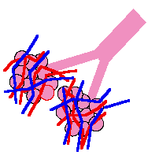
d) The Transport of Respiratory Gases
From the Lungs to the Blood
The smallest structure of the lungs are called the alveoli.
1. Alveoli:
Structure: The millions of alveoli which are tiny air sacs, appear like clusters of grapes.
The alveoli are surrounded by a tremendous network of small blood vessels called capillaries which contain contains blood.
The oxygen that has been inhaled diffuses (moves) from the alveoli into the capillaries.
At the same time, carbon dioxide (that is a waste product of cellular respiration from cells) diffuses (moves) from the capillaries into the alveoli.

Slide 14
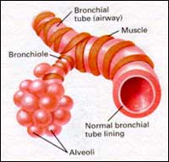

Slide 15
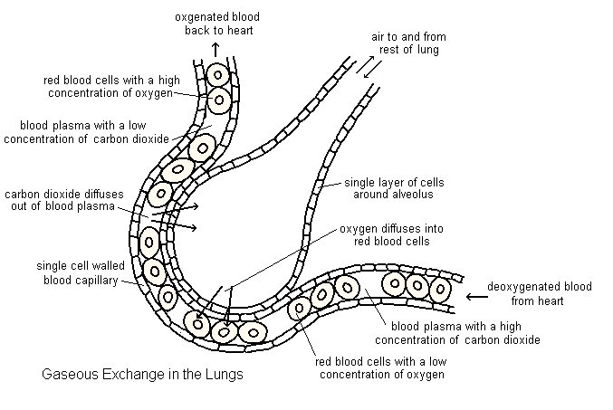
The Basic Structure of the Lungs: The Alveoli

Slide 16
e) Diseases of the Lungs
1. Pneumonia
An infection of the alveoli.
Caused by many kinds of both bacteria (e.g., Streptococcus pneumoniae) and viruses.
Fluids accumulate in the alveoli reducing the surface area exposed to air.
2. Asthma
Constriction of the bronchi and bronchioles making it more difficult to breathe.
Attacks of asthma can be triggered by airborne irritants such as chemical fumes and cigarette smoke.

Slide 17
Emphysema
The delicate walls of the alveoli break down, reducing the gas exchange area of the lungs.
The cause of emphysema is smoking.
4. Cystic fibrosis
A genetic disorder causing the lungs to produce large amounts of a heavy mucus that plugs the airways.
Cystic fibrosis is the most common inherited disease in the U.S. white population.
5. Lung Cancer
Most common cancer and the most common cause of cancer deaths in U.S. males.
Since 1987 U.S. women have been dying in larger numbers from lung cancer than from breast cancer.
Lung cancer is an uncontrolled growth of cells resulting in tumors.

Slide 18
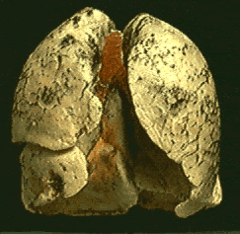
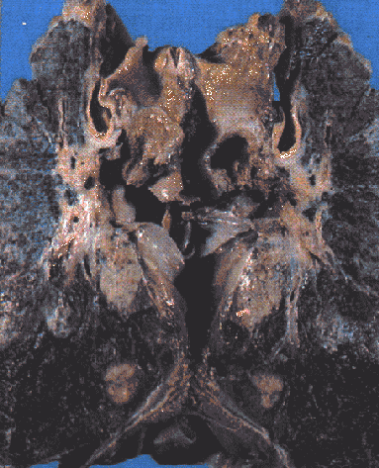
LUNG CANCER
EMPHYSEMA
Tumorous, blackened lungs
Lung tissue completely broken down

Slide 19
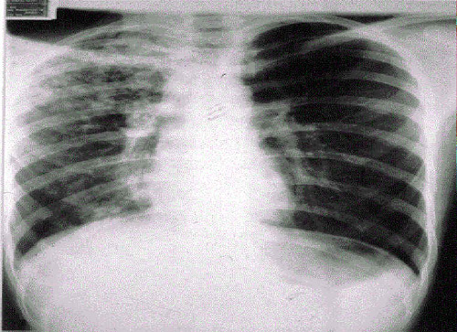
PNEUMONIA
X-ray showing the accumulation of fluid in the lungs

